Slide 1
Dataset Extraction with REST API
„Make your data shine!“
2022

Slide 2









SPEAKER
LinkedIn Štěpán Rešl
Twitter @tpnRel1
ŠTĚPÁN REŠL
Zkušenosti VBA programování Power Platform konzultant
Power BI konzultant
Power BI školitel
Power BI mentor
Zkušenosti Business analýza
Project management
Power Platform Lead
Portfolio management
COO

Slide 3
AGENDA - Quick Demo - REST API - Purposes - Limitations - How to call it - Working with outputs - Demos

Slide 4
QUICK DEMO
Notes:
Story to the beginning:
Like any other company, we wanted to make our education more exciting and fun. So they came up with a simple form of application that generates questions daily, and employees should answer those questions so that they can improve. The concept is simple, but hand in the heart ... Who among us would enjoy something like this for a long time. There aren't many like that. So we started evaluating the reactions. Who answers how fast, correctness, understanding of the topic, etc.? We have prepared a Power BI Report. It is updated daily and evaluates the overall success ranking for the previous week once a week. That moved us forward. But it still forced people to open a report to find out how they were doing, which quickly became annoying, and it didn't meet the gamification element we wanted to get into the whole problem. So we wanted something that wouldn't disturb employees by having to change the interface where they work, and since most of the time they keep MS Teams open, that was a clear choice. You need to get those results into their private chat. If possible, get their results so that they have their results and click on the total.

Slide 5
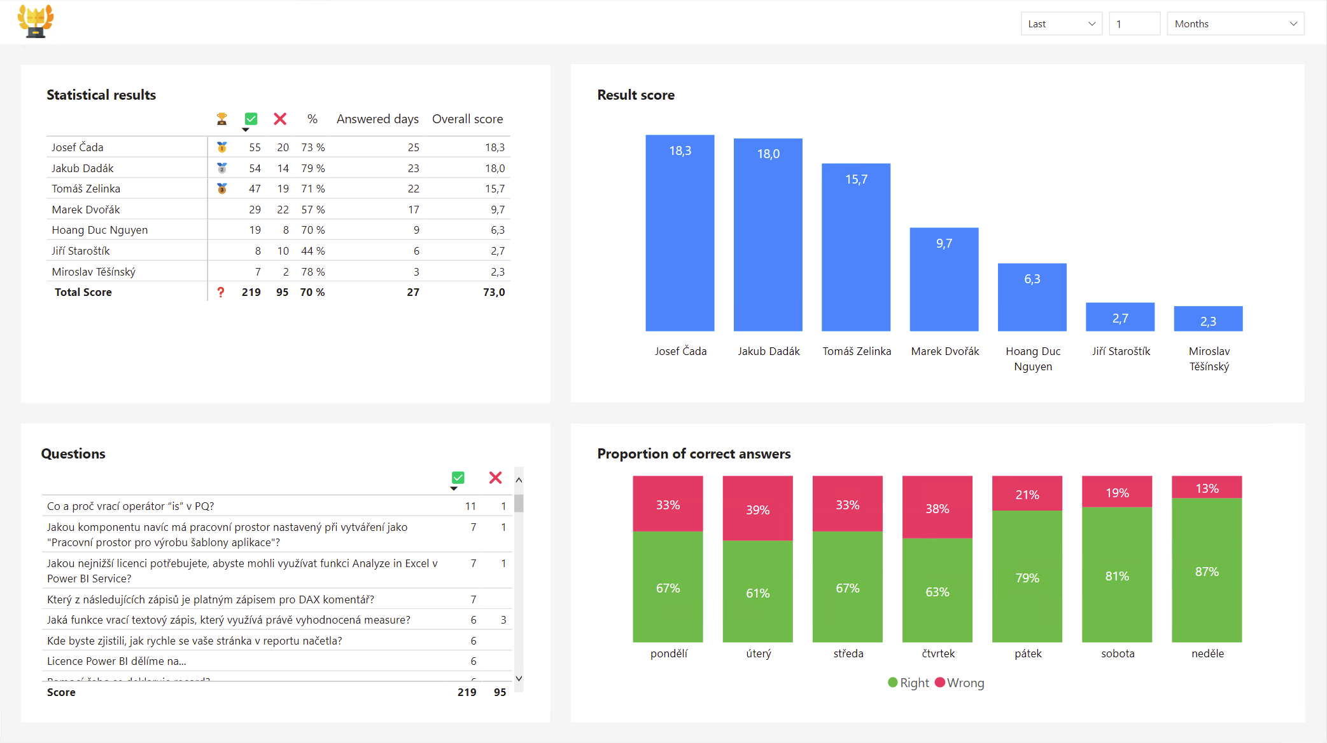
So It could look like this

Slide 6

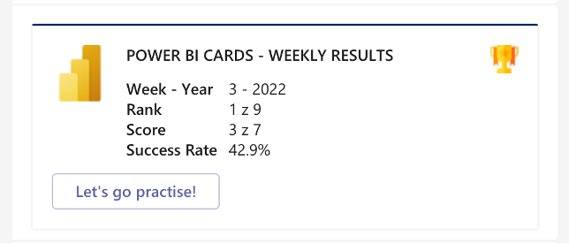
So It could look like this

Slide 7
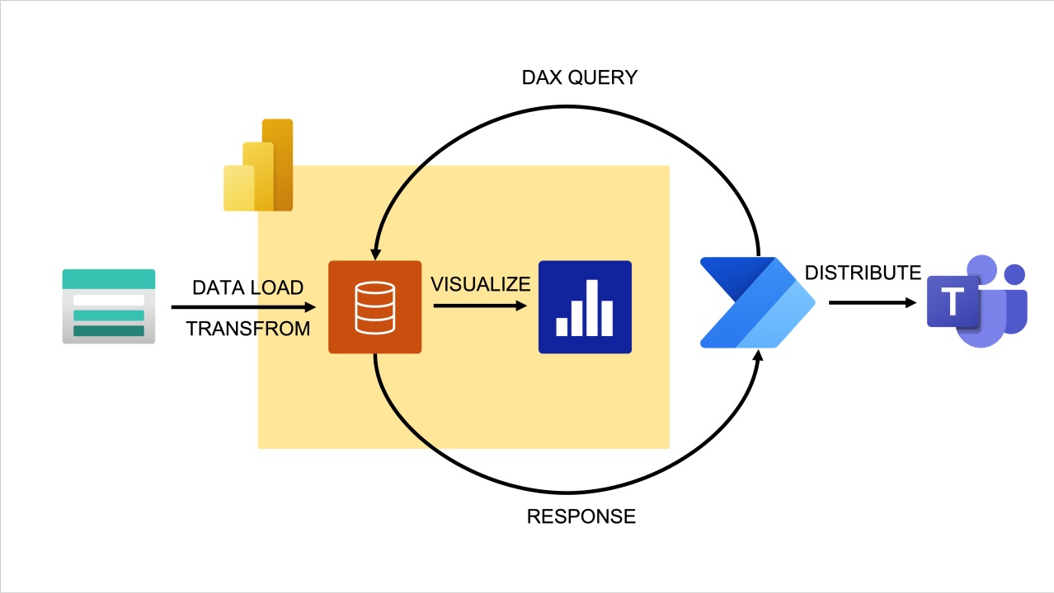
Schema of Demo

Slide 8
WHAT IS POWER BI REST API

Slide 9











POWER BI REST API
GET| POST | PUT | UPDATE | DELETE

Slide 10
PURPOSE

Slide 11




Purposes
Export Data
Testing Datasets
Automize Agenda By Data
Bring Data Closer to Users

Slide 12
LIMITATIONS

Slide 13

Limitations
per call
100 000 Rows
1 000 000 Values
1 Query
120 Queries per minute

Slide 14
HOW TO CALL IT

Slide 15
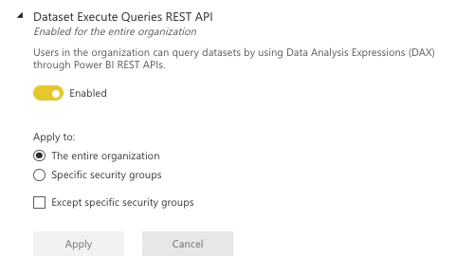
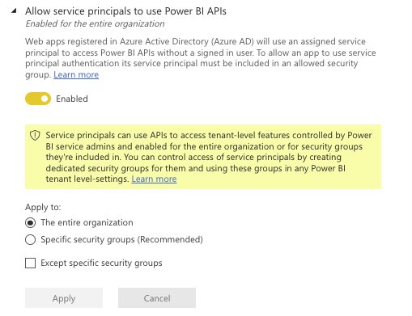
Necessary settings

Slide 16


Authorization?
*
SERVICE PRINCIPAL
USER
* DOESN’T SUPPORT DATASETS WITH RLS

Slide 17


NATIVE CALLERS
Power Automate
Logic Apps

Slide 18
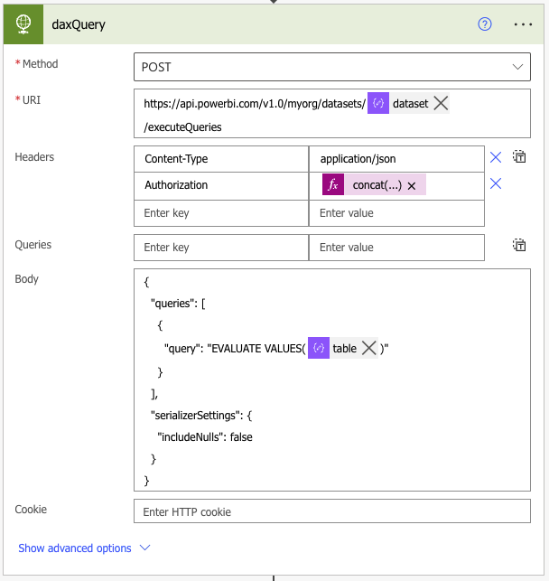
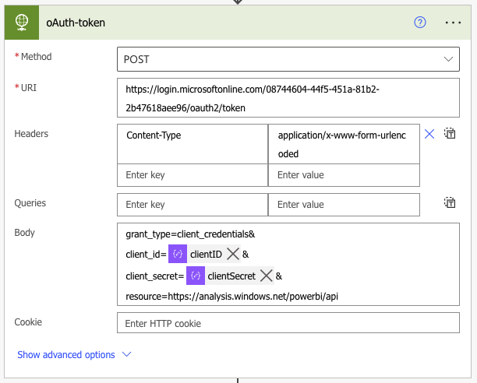
HISTORY

Slide 19
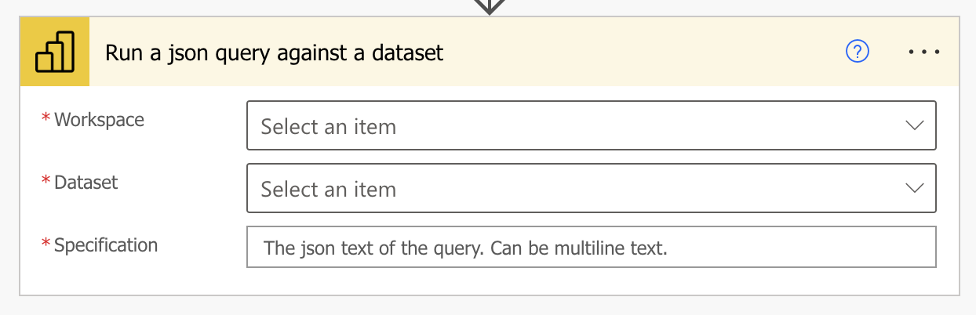
ACTUAL v1
{
"queries": [
{
"query": "EVALUATE VALUES(‘Employees’)"
}
],
"serializerSettings": {
"includeNulls": false
}
}

Slide 20
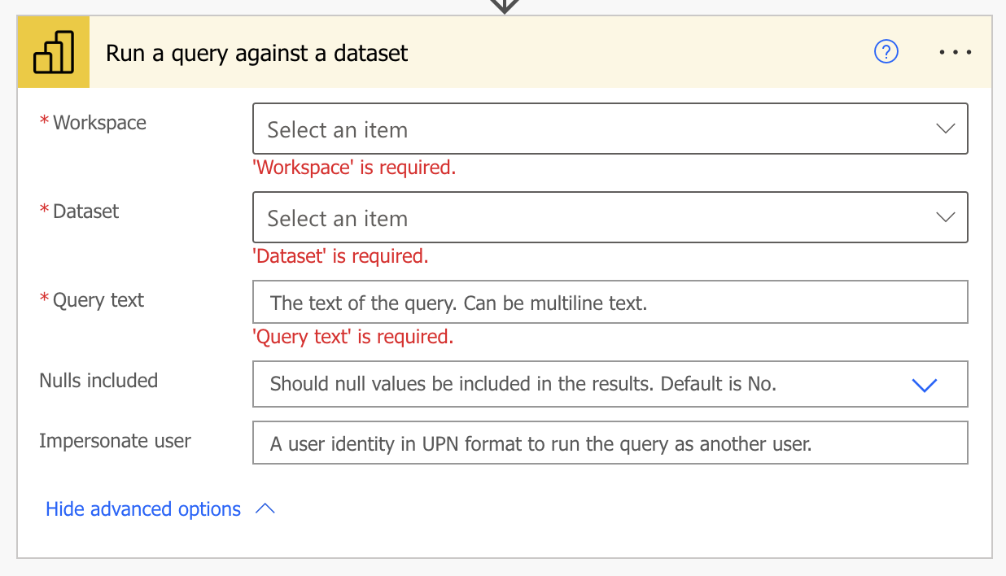
ACTUAL v2
EVALUATE lastWeek
EVALUATE ADDCOLUMNS ( lastWeek, "@forename", RELATED ( 'Employees'[Forname] )
)
DEFINE VAR _t = ADDCOLUMNS ( SUMMARIZE ( 'Employees', [Forname] ), "@counter", CALCULATE ( COUNTROWS ( pbiCardResults ) ) ) VAR _sum = SUMX ( _t, [@counter] ) EVALUATE { _sum }
EVALUATE TOPNSKIP ( 2, 3, lastWeek, lastWeek[Index], ASC )

Slide 21
ACTUAL v2
!!
!!

Slide 22
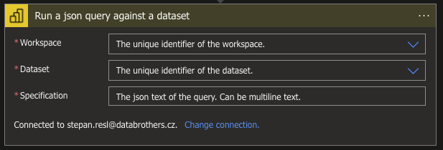
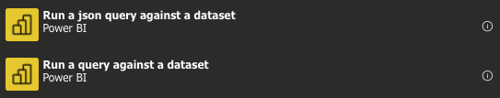
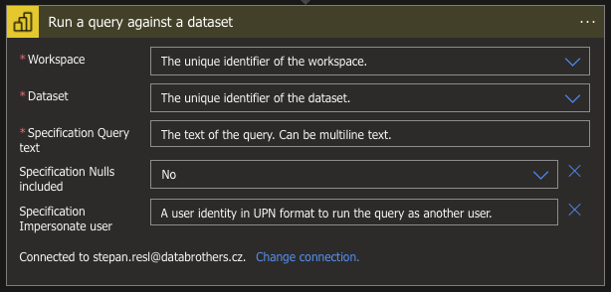
LOGIC APPS

Slide 23
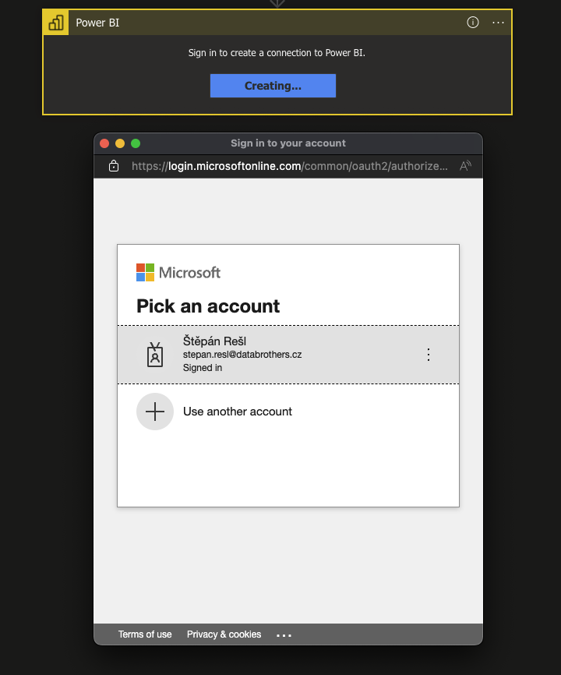
LOGIC APPS
{
"inputs": {
"host": {
"connection": {
"name": "@parameters('$connections')['powerbi']['connectionId']"
}
},
"method": "post",
"body": {
"query": "EVALUTATE 'Zaměstnanci'",
"serializerSettings": {
"includeNulls": false
},
"impersonatedUserName": "josef.cada@databrothers.cz"
},
"path": "/v1.0/myorg/groups/@{encodeURIComponent('c88c00e0-a353-45c3-83b8-db68685e0046')}/datasets/@{encodeURIComponent('71850a1e-ae97-41b0-85e1-02b1e9fead29')}/executeQueries",
"queries": {
"pbi_source": "powerAutomate"
}
}
}

Slide 24
Same capabilities
=
Power Automate
Logic Apps

Slide 25
Working with Outputs

Slide 26
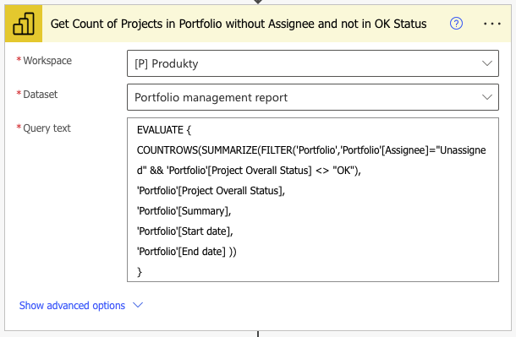
Working single row output

Slide 27
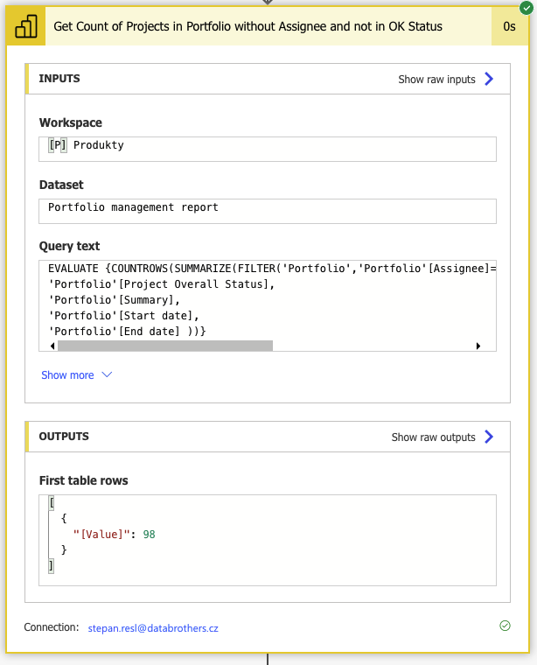
Working with Outputs

Slide 28
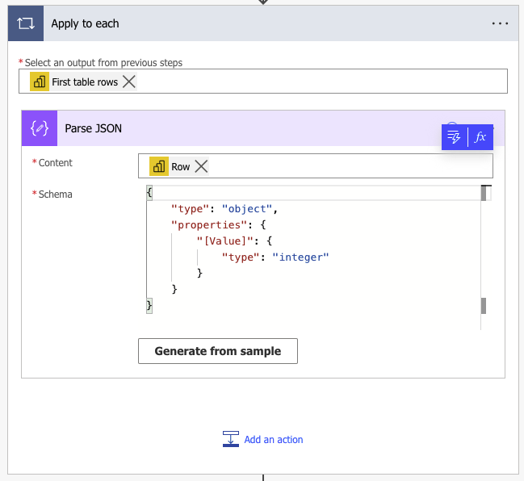
Extract by Apply to each

Slide 29
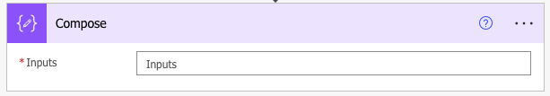
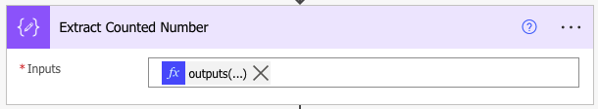
Extract by Compose
outputs('Get_Count_of_Projects_in_Portfolio_without_Assignee_and_not_in_OK_Status')?['body/firstTableRows']?[0]?['[Value]']

Slide 30
Extract by Compose
Returns entire response of API
outputs(…)
Returns all rows from extracted table
outputs(…)?['body/firstTableRows']
Returns first row from extracted table
outputs(…)?['body/firstTableRows']?[0]
Returns exact value from first row from extracted table
outputs(…)?['body/firstTableRows']?[0]?['[Value]']

Slide 31
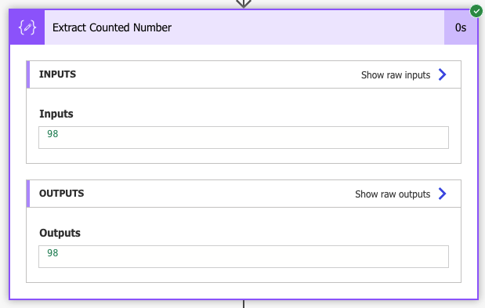
POWER BI REST API

Slide 32
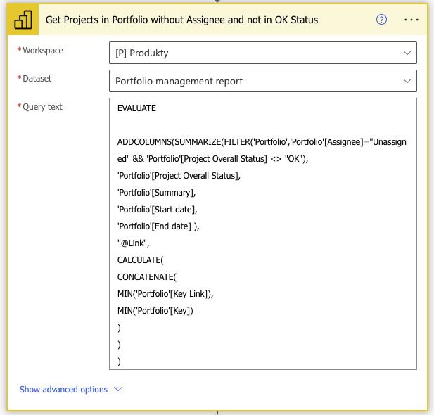
Working with multiple row output

Slide 33
Working with multiple row output
[
{
"Portfolio[Project Overall Status]": "N/A",
"Portfolio[Summary]": "Application Of Machine Learning Prediction Algorithm",
"Portfolio[Start date]": "2019-07-17T00:00:00",
"[@Link]": "https://reportee.cz/cs/HHH-9"
},
{
"Portfolio[Project Overall Status]": "ISSUE",
"Portfolio[Summary]": "Application Of Azure Synapse",
"Portfolio[Start date]": "2019-07-17T00:00:00",
"[@Link]": "https://reportee.cz/cs/HHH-9"
},
{
"Portfolio[Project Overall Status]": "RISK",
"Portfolio[Summary]": "Mining Worker Safety Helmet",
"Portfolio[Start date]": "2021-01-01T00:00:00",
"Portfolio[End date]": "2022-02-28T00:00:00",
"[@Link]": "https://reportee.cz/cs/HHH-134"
}
]

Slide 34
DEMOS

Slide 35
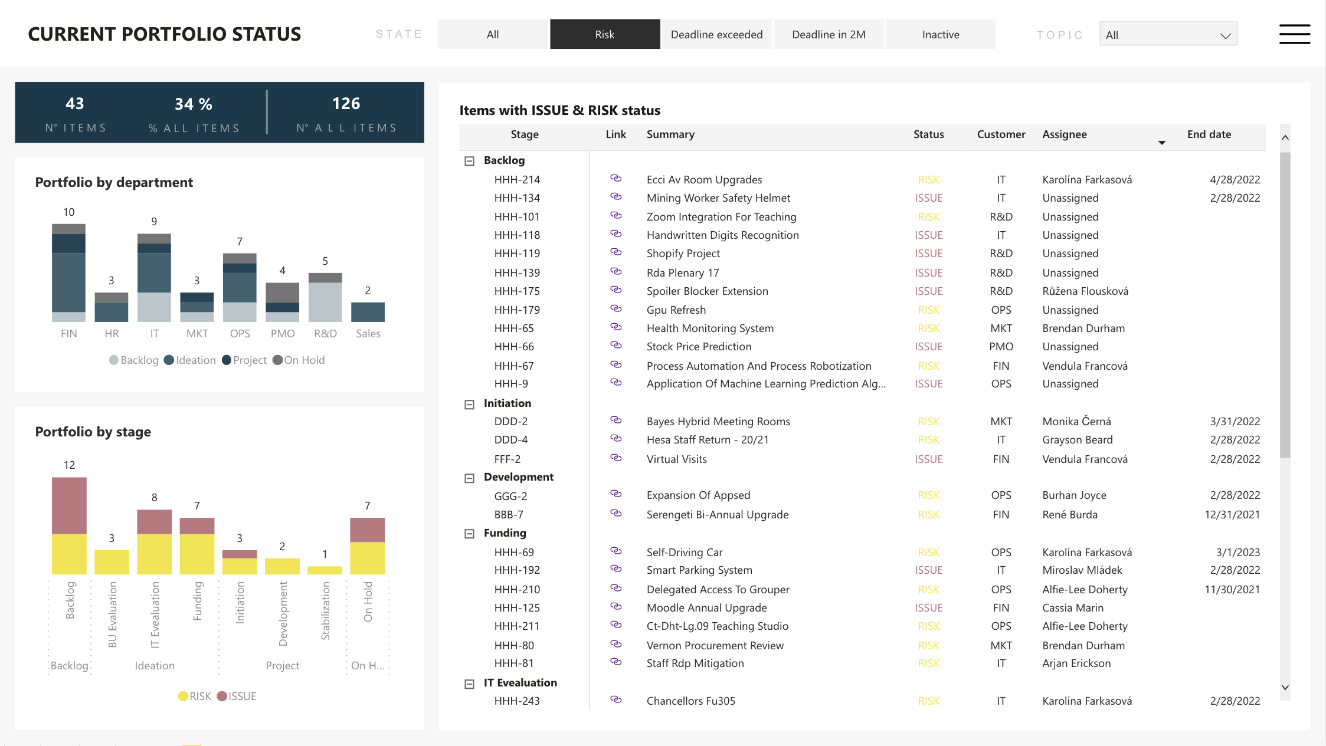
Determining project owner assignments

Slide 36
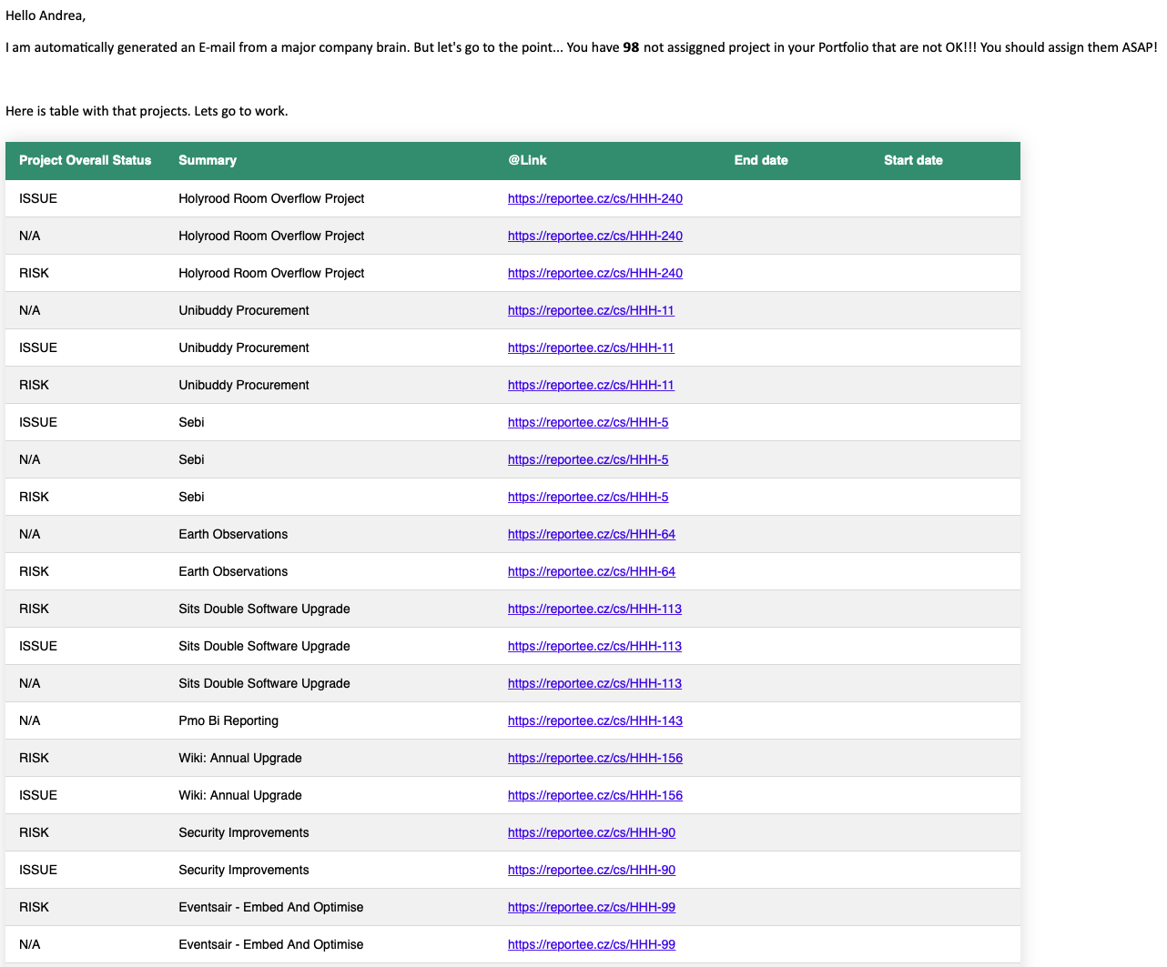
Determining project owner assignments

Slide 37
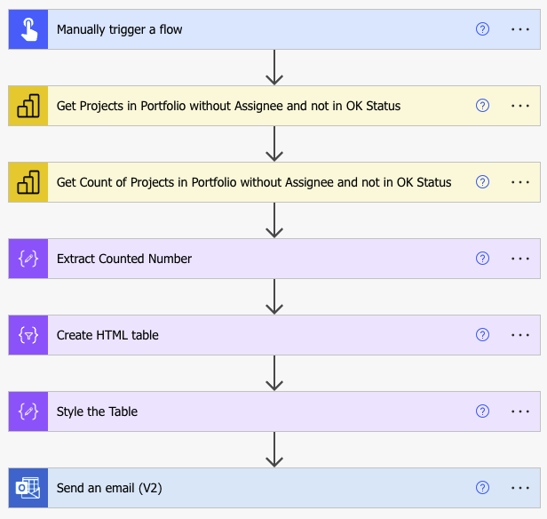
Determining project owner assignments

Slide 38
THANK YOU FOR THE ATTENTION

